Slide 1

Probability of Default
A Mock Project demonstrating model development and insights
By: Karen Atkinson
October 2024

Slide 2
Objective: The primary purpose of the Probability of Default model is to quantitatively assess the likelihood that a borrower will default on a loan within a specified time frame.
Risk Assessment: to differentiate between high-risk and low-risk customers, helping to reduce potential losses
Credit Policy Development: assist in setting appropriate interest rates based on borrower’s predicted default risk
Impact on Lending Decisions: by focusing resources on higher-potential borrowers while minimizing exposure to those deemed risky
Regulatory Compliance: ensure compliance with regulatory standards by providing quantifiable metrics that regulators can review
Notes:
Overview of the Project: Highlight the business problem (credit default prediction) and how your model solves it.

Slide 3

Income – indicates financial stability, higher income reduces default risk
Credit Score – reflects past credit behaviour; essential for predicting repayment likelihood
Loan Amount – needs to align with borrower capacity; larger loans may increase borrower risk
Employment Years – longer employment suggests stability; linked to better repayment performance
Payment History – Strong predictor of future behaviour; past on-time payments correlate with lower default risk
Credit Utilization – higher utilization indicates potential distress; lower rates improve repayment likelihood
Account Age – older accounts demonstrate credit management experience; associated with reduced risk
Features used in Model
Notes:
Data Used: Explain the features used and why they’re relevant.

Slide 4
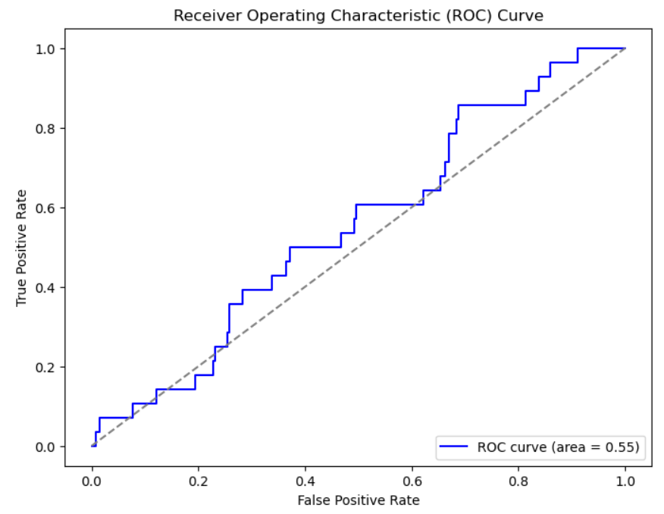
Model Performance
AUC Score: 0.567 (Scaled)
Measures model’s ability to identify borrowers that default
Higher values (closer to 1) indicate better performance
ROC Curve: demonstrates the trade-off between catching defaults (sensitivity) and avoiding false alarms (specificity), helping assess model performance
Notes:
Model Performance: Present key metrics like AUC, confusion matrix, and ROC curve.

Slide 5
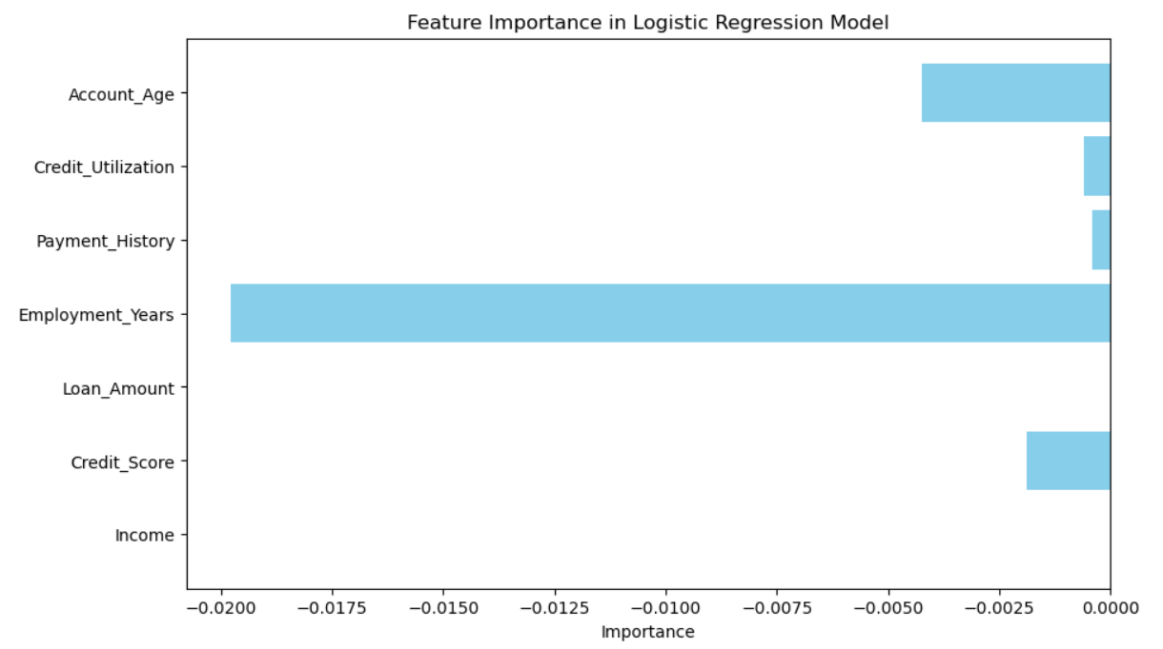
Key Features and Business Implications
Feature Importance:
Employment Years and Account Age have the highest influence on default predictions.
Business Implications:
Focus on customers with fewer employment years to mitigate default risk
Tailor lending strategies for customers with longer account histories
Notes:
Key Features: Show the most important features driving the model’s predictions.

Slide 6

Summary of Findings:
The model effectively identifies key factors influencing default risk, with Employment Years and Account Age emerging as top predictors. Model performance, while promising, highlights areas for improvement.
Recommendations:
Refine the model by enhancing feature engineering and testing more advanced algorithms
Conduct further analysis on underperforming features to improve predictive accuracy
Notes:
Business Implications: Connect the model’s output to actionable insights for the company (e.g., better lending decisions, risk management).

